Slide 1
DBMS: Deadlock Handling
Akhilesh Arya

Slide 2
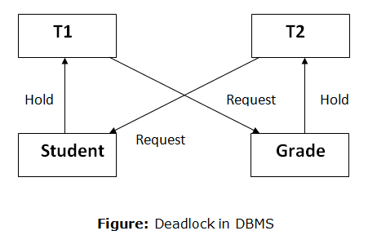
Deadlock in DBMS
A deadlock is a condition where two or more transactions are waiting indefinitely for one another to give up locks

Slide 3
Deadlock Detection
In a database, when a transaction waits indefinitely to obtain a lock, then the DBMS should detect whether the transaction is involved in a deadlock or not
The lock manager maintains a Wait for the graph to detect the deadlock cycle in the database

Slide 4
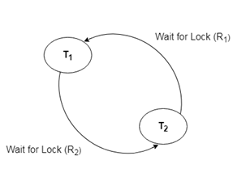
Wait for Graph
This is the suitable method for deadlock detection
In this method, a graph is created based on the transaction and their lock
If the created graph has a cycle or closed loop, then there is a deadlock

Slide 5
Deadlock Handling
There are 2 methods of deadlocking handling:
Deadlock Prevention
Detection and Recovery

Slide 6
Deadlock Prevention
Violate the properties such as mutual exclusion, Hold and Wait, Preemption and circular weight
If none or one of the property is not present in the transaction then definitely we can prevent deadlock

Slide 7
Deadlock Recovery
Wait- Die (Non- Preemptive)
If TS(Ti) < TS(Tj) then Ti must wait (Ti is older)
If TS(Ti) > TS(Tj) then Ti rollback (Die)
Wound- Wait (Preemptive)
If TS(Ti) > TS(Tj) then Ti can wait (Ti is yonger)
If TS(Ti) < TS(Tj) then Tj rollback (Die)

